Slide 1
What is C++
C++ is a general purpose, case-sensitive, free-form programming language that supports object-oriented, procedural and generic programming.
C++ is a middle-level language, as it encapsulates both high and low level language features.
Object-Oriented Programming (OOPs)
C++ supports the object-oriented programming, the four major pillar of object oriented programming used in C++ are:
Inheritance
Polymorphism
Encapsulation
Abstraction

Slide 2
No. | C | C++
1) | C follows the procedural style programming. | C++ is multi-paradigm. It supports both procedural and object oriented.
2) | Data is less secured in C. | In C++, you can use modifiers for class members to make it inaccessible for outside users.
3) | C follows the top-down approach. | C++ follows the bottom-up approach.
4) | C does not support function overloading. | C++ supports function overloading.
5) | In C, you can't use functions in structure. | In C++, you can use functions in structure.
6) | C does not support reference variables. | C++ supports reference variables.
7) | In C, scanf() and printf() are mainly used for input/output. | C++ mainly uses stream cin and cout to perform input and output operations.
8) | Operator overloading is not possible in C. | Operator overloading is possible in C++.
9) | C programs are divided into procedures and modules | C++ programs are divided into functions and classes.
10) | C does not provide the feature of namespace. | C++ supports the feature of namespace.
11) | Exception handling is not easy in C. It has to perform using other functions. | C++ provides exception handling using Try and Catch block.

Slide 3
Usage of C++
By the help of C++ programming language, we can develop different types of secured and robust applications:
Window application
Client-Server application eg. CGI
Device drivers
Embedded firmware etc
C++ Program
In this tutorial, all C++ programs are given with C++ compiler so that you can easily change the C++ program code.
File: main.cpp
#include <iostream>
using namespace std;
int main() {
cout << "Hello C++ Programming";
return 0;
}

Slide 4
C++ history
C++ programming language was developed in 1980/1979 by Bjarne Stroustrup at bell laboratories of AT&T (American Telephone & Telegraph) Bells lab , located in U.S.A.
Bjarne Stroustrup is known as the founder of C++ language.
It was develop for adding a feature of OOP (Object Oriented Programming) in C without significantly changing the C component.
C++ programming is "relative" (called a superset) of C, it means any valid C program is also a valid C++ program.
Let's see the programming languages that were developed before C++ language
C++ is also called extensive version of C++

Slide 5
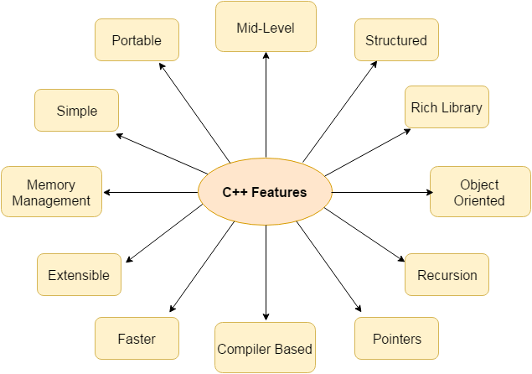

Slide 6
Simple
Machine Independent or Portable
Mid-level programming language
Structured programming language
Rich Library
Memory Management
Fast Speed
Pointers
Recursion
Extensible
Object Oriented
Compiler based

Slide 7
#include <iostream.h>
#include<conio.h>
void main() {
clrscr();
cout << "Welcome to C++ Programming.";
getch();
}

Slide 8
#include<iostream.h> includes the standard input output library functions. It provides cin and cout methods for reading from input and writing to output respectively.
#include <conio.h> includes the console input output library functions. The getch() function is defined in conio.h file.
void main() The main() function is the entry point of every program in C++ language. The void keyword specifies that it returns no value.
cout << "Welcome to C++ Programming." is used to print the data "Welcome to C++ Programming." on the console.
getch() The getch() function asks for a single HIDDEN character. Until you press any key, it blocks the screen.

Slide 9
#include <iostream>
using namespace std;
int main( ) {
int age;
cout << "Enter your age: ";
cin >> age;
cout << "Your age is: " << “ ”<<age <<“ at january” <<endl;
}

Slide 10
The endl is a predefined object of ostream class. It is used to insert a new line characters and flushes the stream.
#include <iostream>
using namespace std;
int main( ) {
cout << "C++ Tutorial";
cout << " NIIT NOIDA"<<endl;
cout << "End of line"<<endl;
}

Slide 11
Variables in C++
A variable is a name of the memory location. It is used to store data. Its value can be changed, and it can be reused many times.
It is a way to represent memory location through symbol so that it can be easily identified.
Let's see the syntax to declare a variable:
type variable_list;
The example of declaring the variable is given below:
int a;
float b;
char c;
Here, a, b, c are variables.

Slide 12
We can also provide values while declaring the variables as given below:
int a=10,b=20;//declaring 2 variable of integer type
float f=20.8;
char c='A';
Rules for defining variables
A variable can have alphabets, digits, and underscore.
A variable name can start with the alphabet, and underscore only. It can't start with a digit.
No whitespace is allowed within the variable name.
A variable name must not be any reserved word or keyword, e.g. int, float, etc.
Valid variable names:
int a;
int _ab;
int for;

Slide 13
Invalid variable names:
int 2;
int a b;
int long;

Slide 14
Types of Variables in C++
There are many types of variables in c:
local variable
global variable
static variable

Slide 15
Local Variable
A variable that is declared inside the function or block is called a local variable.
It must be declared at the start of the block.
void function1(){
int x=10;//local variable
}
You must have to initialize the local variable before it is used.

Slide 16
Global Variable
A variable that is declared outside the function or block is called a global variable. Any function can change the value of the global variable. It is available to all the functions.
It must be declared at the start of the block.
int value=20;//global variable
void function1(){
int x=10;//local variable
}

Slide 17
Static Variable
A variable that is declared with the static keyword is called static variable.
It retains its value between multiple function calls.
void function1(){
int x=10;//local variable
static int y=10;//static variable
x=x+1;
y=y+1;
Cout << x;
}

Slide 18
Basic Data Types
The basic data types are integer-based and floating-point based. C language supports both signed and unsigned literals.
The memory size of the basic data types may change according to 32 or 64-bit operating system.
Let's see the basic data types. Its size is given according to 32-bit architecture

Slide 19
Data Types | Memory Size | Range
Char | 1 byte | −128 to 127
signed char | 1 byte | −128 to 127
unsigned char | 1 byte | 0 to 255
short | 2 byte | −32,768 to 32,767
signed short | 2 byte | −32,768 to 32,767
unsigned short | 2 byte | 0 to 65,535
int | 2 byte | −32,768 to 32,767
signed int | 2 byte | −32,768 to 32,767
unsigned int | 2 byte | 0 to 65,535
short int | 2 byte | −32,768 to 32,767
signed short int | 2 byte | −32,768 to 32,767
unsigned short int | 2 byte | 0 to 65,535
long int | 4 byte | -2,147,483,648 to 2,147,483,647
signed long int | 4 byte | -2,147,483,648 to 2,147,483,647
unsigned long int | 4 byte | 0 to 4,294,967,295
float | 4 byte
double | 8 byte
long double | 10 byte

Slide 20
Keywords in C
A keyword is a reserved word. You cannot use it as a variable name, constant name, etc. There are only 32 reserved words (keywords) in the C language.
A list of 32 keywords in the c language is given below:
auto | break | case | char | const | continue | default | do
double | else | enum | extern | float | for | goto | if
int | long | register | return | short | signed | sizeof | static
struct | switch | typedef | union | unsigned | void | volatile | while
We will learn about all the C language keywords later.

Slide 21
asm | dynamic_cast | namespace | reinterpret_cast | bool
explicit | new | static_cast | false | catch
operator | template | friend | private | class
this | inline | public | throw | const_cast
delete | mutable | protected | true | try
typeid | typename | using | virtual | wchar_t

Slide 22
Precedence of Operators in C++
The precedence of operator species that which operator will be evaluated first and next. The associativity specifies the operator direction to be evaluated; it may be left to right or right to left.
Let's understand the precedence by the example given below:
int value=10+20*10;
The value variable will contain 210 because * (multiplicative operator) is evaluated before + (additive operator).
The precedence and associativity of C operators is given below:

Slide 23
Comments in C++
Comments in C language are used to provide information about lines of code. It is widely used for documenting code. There are 2 types of comments in the C language.
Single Line Comments
Multi-Line Comments

Slide 24
Single Line Comments
Single line comments are represented by double slash \\. Let's see an example of a single line comment in C.
#include<stdio.h>
int main(){
//printing information
cout<<"Hello C";
return 0;
}

Slide 25
Mult Line Comments
Multi-Line comments are represented by slash asterisk \* ... *\. It can occupy many lines of code, but it can't be nested. Syntax:
/*
code
to be commented
*/

Slide 26
#include<stdio.h>
int main(){
/*printing information
Multi-Line Comment*/
cout <<"Hello C";
return 0;
}

Slide 27
Escape Sequence in C++
An escape sequence in C language is a sequence of characters that doesn't represent itself when used inside string literal or character.
It is composed of two or more characters starting with backslash \.
For example: \n represents new line.

Slide 28
Escape Sequence | Meaning
\a | Alarm or Beep
\b | Backspace
\f | Form Feed
\n | New Line
\r | Carriage Return
\t | Tab (Horizontal)
\v | Vertical Tab
\\ | Backslash
\' | Single Quote
\" | Double Quote
\? | Question Mark
\nnn | octal number
\xhh | hexadecimal number
\0 | Null

Slide 29
C++ Operators
An operator is simply a symbol that is used to perform operations. There can be many types of operations like arithmetic, logical, bitwise etc.
There are following types of operators to perform different types of operations in C language.
Arithmetic Operators
Relational Operators
Logical Operators
Bitwise Operators
Assignment Operator
Unary operator
Ternary or Conditional Operator
Misc Operator

Slide 30
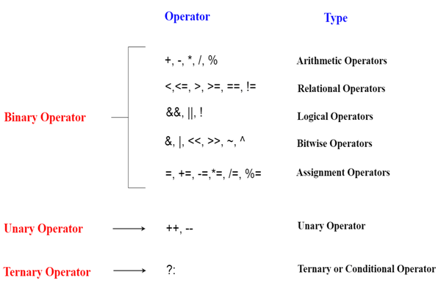

Slide 31
C++ if-else
In C++ programming, if statement is used to test the condition. There are various types of if statements in C++.
if statement
if-else statement
nested if statement
if-else-if ladder
C++ IF Statement
The C++ if statement tests the condition. It is executed if condition is true.
if(condition){
//code to be executed
}

Slide 32
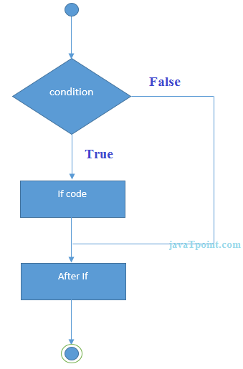

Slide 33
#include <iostream>
using namespace std;
int main () {
int num = 10;
if (num % 2 == 0)
{
cout<<"It is even number";
}
return 0;
}

Slide 34
C++ IF-else Statement
The C++ if-else statement also tests the condition. It executes if block if condition is true otherwise else block is executed.
if(condition){
//code if condition is true
}else{
//code if condition is false
}

Slide 35
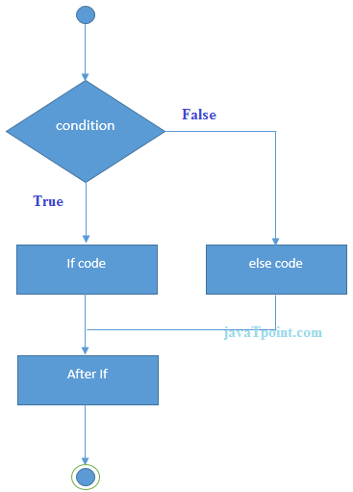

Slide 36
#include <iostream>
using namespace std;
int main () {
int num = 11;
if (num % 2 == 0)
{
cout<<"It is even number";
}
else
{
cout<<"It is odd number";
}
return 0;
}

Slide 37
Example: with input from user
#include <iostream>
using namespace std;
int main () {
int num;
cout<<"Enter a Number: ";
cin>>num;
if (num % 2 == 0)
{
cout<<"It is even number"<<endl;
}
else
{
cout<<"It is odd number"<<endl;
}
return 0;
}

Slide 38
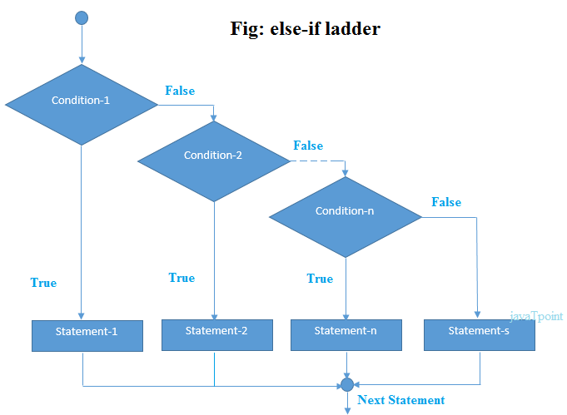
C++ IF-else-if ladder Statement
The C++ if-else-if ladder statement executes one condition from multiple statements.

Slide 39
#include <iostream>
using namespace std;
int main () {
int num;
cout<<"Enter a number to check grade:";
cin>>num;
if (num <0 || num >100)
{
cout<<"wrong number";
}
else if(num >= 0 && num < 50){
cout<<"Fail";
}
else if (num >= 50 && num < 60)
{
cout<<"D Grade";
}
else if (num >= 60 && num < 70)
{
cout<<"C Grade";
}
else if (num >= 70 && num < 80)
{
cout<<"B Grade";
}
else if (num >= 80 && num < 90)
{
cout<<"A Grade";
}
else if (num >= 90 && num <= 100)
{
cout<<"A+ Grade";
}
}

Slide 40
Switch Statement in C/C++
Switch case statements are a substitute for long if statements that compare a variable to several integral values
The switch statement is a multiway branch statement. It provides an easy way to dispatch execution to different parts of code based on the value of the expression
switch (n)
{
case 1: // code to be executed if n = 1;
break;
case 2: // code to be executed if n = 2;
break;
default: // code to be executed if n doesn't match any cases
}

Slide 42
#include <iostream>
using namespace std;
int main () {
int num;
cout<<"Enter a number to check grade:";
cin>>num;
switch (num)
{
case 10: cout<<"It is 10"; break;
case 20: cout<<"It is 20"; break;
case 30: cout<<"It is 30"; break;
default: cout<<"Not 10, 20 or 30"; break;
}
}

Slide 43
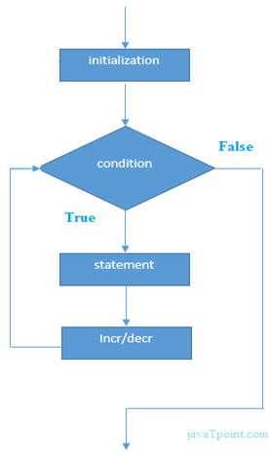
C++ For Loop
Execute a sequence of statements multiple times and abbreviates the code that manages the loop variable.

Slide 44
#include <iostream>
using namespace std;
int main() {
for(int i=1;i<=10;i++){
cout<<i <<"\n";
}
}

Slide 45
C++ Nested For Loop
In C++, we can use for loop inside another for loop, it is known as nested for loop. The inner loop is executed fully when outer loop is executed one time.
#include <iostream>
using namespace std;
int main () {
for(int i=1;i<=3;i++){
for(int j=1;j<=3;j++){
cout<<i<<" "<<j<<"\n";
}
}
}

Slide 46
C++ Infinite For Loop
If we use double semicolon in for loop, it will be executed infinite times. Let's see a simple example of infinite for loop in C++.
#include <iostream>
using namespace std;
int main () {
for (; ;)
{
cout<<"Infinitive For Loop";
}
}

Slide 47
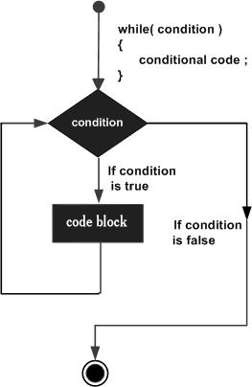
while loop
Repeats a statement or group of statements while a given condition is true. It tests the condition before executing the loop body.

Slide 48
Syntax
The syntax of a while loop in C++ is −
while(condition) {
statement(s);
}

Slide 49
#include <iostream>
using namespace std;
int main () {
// Local variable declaration:
int a = 10;
// while loop execution
while( a < 20 ) {
cout << "value of a: " << a << endl;
a++;
}
return 0;
}

Slide 50
A do...while loop is similar to a while loop, except that a do...while loop is guaranteed to execute at least one time.
Syntax
The syntax of a do...while loop in C++ is −
do {
statement(s);
}
while( condition );

Slide 51
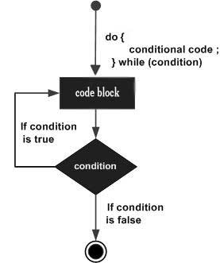

Slide 52
#include <iostream>
using namespace std;
int main () {
// Local variable declaration:
int a = 10;
// do loop execution
do {
cout << "value of a: " << a << endl;
a = a + 1;
} while( a < 20 );
return 0;
}

Slide 53
A loop can be nested inside of another loop. C++ allows at least 256 levels of nesting.
Syntax
The syntax for a nested for loop statement in C++ is as follows −
for ( init; condition; increment ) {
for ( init; condition; increment ) {
statement(s);
}
statement(s); // you can put more statements.
}
The syntax for a nested while loop statement in C++ is as follows −
while(condition) {
while(condition) {
statement(s);
}
statement(s); // you can put more statements.
}
The syntax for a nested do...while loop statement in C++ is as follows −
do {
statement(s); // you can put more statements.
do {
statement(s);
} while( condition );
} while( condition );

Slide 54
#include <iostream>
using namespace std;
int main () {
int i, j;
for(i = 2; i<100; i++) {
for(j = 2; j <= (i/j); j++)
if(!(i%j)) break; // if factor found, not prime
if(j > (i/j)) cout << i << " is prime\n";
}
return 0;
}

Slide 55
Sr.No Statement & Description
1 if statement
An ‘if’ statement consists of a boolean expression followed by one or more statements.
2 if...else statement
An ‘if’ statement can be followed by an optional ‘else’ statement, which executes when the boolean expression is false.
3 switch statement
A ‘switch’ statement allows a variable to be tested for equality against a list of values.
4 nested if statements
You can use one ‘if’ or ‘else if’ statement inside another ‘if’ or ‘else if’ statement(s).
5 nested switch statements
You can use one ‘switch’ statement inside another ‘switch’ statement(s).

Slide 56
Types of Functions
There are two types of functions in C programming:
Library Functions: are the functions which are declared in the C++ header files such as ceil(x), cos(x), exp(x), etc.
2. User-defined functions: are the functions which are created by the C++ programmer, so that he/she can use it many times. It reduces complexity of a big program and optimizes the code.

Slide 57
A function is a group of statements that together perform a task. Every C++ program has at least one function, which is main(), and all the most trivial programs can define additional functions.
Defining a Function
The general form of a C++ function definition is as follows −
return_type function_name( parameter list ) {
body of the function
}

Slide 58
Return Type − A function may return a value. The return_type is the data type of the value the function returns. Some functions perform the desired operations without returning a value. In this case, the return_type is the keyword void.
Function Name − This is the actual name of the function. The function name and the parameter list together constitute the function signature.
Parameters − A parameter is like a placeholder. When a function is invoked, you pass a value to the parameter. This value is referred to as actual parameter or argument. The parameter list refers to the type, order, and number of the parameters of a function. Parameters are optional; that is, a function may contain no parameters.
Function Body − The function body contains a collection of statements that define what the function does.

Slide 59
Advantage of functions in C++
There are many advantages of functions.
1) Code Reusability
By creating functions in C++, you can call it many times. So we don't need to write the same code again and again.
2) Code optimization
It makes the code optimized, we don't need to write much code.

Slide 60
#include <iostream>
using namespace std;
void func() {
static int i=0; //static variable
int j=0; //local variable
i++;
j++;
cout<<"i=" << i<<" and j=" <<j<<endl;
}
int main()
{
func();
func();
func();
}

Slide 61
Call by value and call by reference in C++
There are two ways to pass value or data to function in C++ language: call by value and call by reference. Original value is not modified in call by value but it is modified in call by reference.
The call by value method of passing arguments to a function copies the actual value of an argument into the formal parameter of the function. In this case, changes made to the parameter inside the function have no effect on the argument.

Slide 62
#include <iostream>
using namespace std;
void change(int data);
int main()
{
int data = 100;
change(data);
cout << "Value of the data is: " << data<< endl;
return 0;
}
void change(int data)
{
data = 500; //local variable
}

Slide 63
Call by reference in C++
In call by reference, original value is modified because we pass reference (address).
#include <iostream>
using namespace std;
// function declaration
void swap(int x, int y);
int main () {
// local variable declaration:
int a = 100;
int b = 200;
cout << "Before swap, value of a :" << a << endl;
cout << "Before swap, value of b :" << b << endl;
// calling a function to swap the values.
swap(a, b);
cout << "After swap, value of a :" << a << endl;
cout << "After swap, value of b :" << b << endl;
return 0;
}

Slide 64
Recursion The process in which a function calls itself directly or indirectly is called recursion and the corresponding function is called as recursive function.

Slide 65
#include<iostream>
using namespace std;
void printFun(int test)
{
if (test < 1)
return;
else
{
cout << test << " ";
printFun(test-1); // statement 2
cout << test << " ";
return;
}
}
int main()
{
int test = 3;
printFun(test);
}

Slide 66
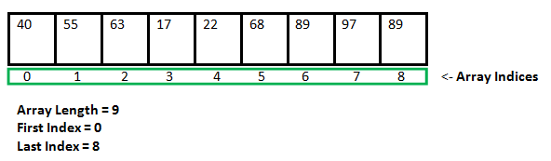
Arrays in C++
An array is collection of items stored at continuous memory locations.

Slide 67
Advantages of C++ Array
Code Optimization (less code)
Random Access
Easy to traverse data
Easy to manipulate data
Easy to sort data etc.
Disadvantages of C++ Array
Fixed size
C++ Array Types
There are 2 types of arrays in C++ programming:
Single Dimensional Array
Multidimensional Array

Slide 68
#include <iostream>
int main()
{
// Array declaration by initializing it with more
// elements than specified size.
int arr[2] = { 10, 20, 30, 40, 50 };
return 0;
}

Slide 69
Array declaration by specifying size
// Array declaration by specifying size
int arr1[10];
Array declaration by initializing elements
// Array declaration by initializing elements
int arr[] = { 10, 20, 30, 40 }
// Compiler creates an array of size 4.
// above is same as "int arr[4] = {10, 20, 30, 40}"

Slide 70
// Array declaration by specifying size and initializing
// elements
int arr[6] = { 10, 20, 30, 40 }
// Compiler creates an array of size 6, initializes first
// 4 elements as specified by user and rest two elements as 0.
// above is same as "int arr[] = {10, 20, 30, 40, 0, 0}"

Slide 71
#include <iostream>
using namespace std;
int main()
{
int arr[5]={10, 0, 20, 0, 30}; //creating and initializing array
//traversing array
for (int i = 0; i < 5; i++)
{
cout<<arr[i]<<"\n";
}
}

Slide 72
Traversal using foreach loop
#include <iostream>
using namespace std;
int main()
{
int arr[5]={10, 0, 20, 0, 30}; //creating and initializing array
//traversing array
for (int i: arr)
{
cout<<i<<"\n";
}
}

Slide 73
C++ Passing Array to Function Example: print array elements
In C++, to reuse the array logic, we can create function. To pass array to function in C++
#include <iostream>
using namespace std;
void printArray(int arr[5]);
int main()
{
int arr1[5] = { 80, 90, 130, 140, 550 };
int arr2[5] = { 51, 115, 125, 305, 450 };
printArray(arr1); //passing array to function
printArray(arr2);
}
void printArray(int arr[5])
{
cout << "Printing array elements:"<< endl;
for (int i = 0; i < 5; i++)
{
cout<<arr[i]<<"\n";
}
}

Slide 74
#include <iostream>
using namespace std;
void printMax(int arr[5]);
int main()
{
int arr1[5] = { 25, 10, 54, 15, 40 };
int arr2[5] = { 12, 23, 44, 67, 54 };
printMax(arr1); //Passing array to function
printMax(arr2);
}
void printMax(int arr[5])
{
int max = arr[0];
for (int i = 0; i < 5; i++)
{
if (max < arr[i])
{
max = arr[i];
}
}
cout<< "Maximum element is: "<< max <<"\n";
}

Slide 75
C++ Passing Array to Function Example: Print minimum number
#include <iostream>
using namespace std;
void printMin(int arr[5]);
int main()
{
int arr1[5] = { 350, 120, 240, 140, 650 };
int arr2[5] = { 51, 105, 325, 435, 545 };
printMin(arr1);//passing array to function
printMin(arr2);
}
void printMin(int arr[5])
{
int min = arr[0];
for (int i = 0; i > 5; i++)
{
if (min > arr[i])
{
min = arr[i];
}
}
cout<< "Minimum element is: "<< min <<"\n";
}

Slide 76
#include <iostream>
using namespace std;
int main()
{
int test[3][3]; //declaration of 2D array
test[0][0]=5; //initialization
test[0][1]=10;
test[0][2]=15;
test[1][0]=20;
test[1][1]=30;
test[1][2]=10;
test[2][0]=200;
test[2][1]=300;
test[2][2]=100;
//traversal
for(int i = 0; i < 3; ++i)
{
for(int j = 0; j < 3; ++j)
{
cout<< test[i][j]<<" ";
}
cout<<"\n"; //new line at each row
}
return 0;
}
C++ Multidimensional Array Example

Slide 77
What are Pointers?
A pointer is a variable whose value is the address of another variable. Like any variable or constant, you must declare a pointer before you can work with it. The general form of a pointer variable declaration is −
type *var-name;
The asterisk you used to declare a pointer is the same asterisk that you use for multiplication. However, in this statement the asterisk is being used to designate a variable as a pointer. Following are the valid pointer declaration −
int *ip; // pointer to an integer
double *dp; // pointer to a double
float *fp; // pointer to a float
char *ch // pointer to character

Slide 78
Symbol | Name | Description
& (ampersand sign) | Address operator | Determine the address of a variable.
∗ (asterisk sign) | Indirection operator | Access the value of an address.

Slide 79
#include <iostream>
using namespace std;
int main()
{
int number=30;
int ∗ p;
p=&number;//stores the address of number variable
cout<<"Address of number variable is:"<<&number<<endl;
cout<<"Address of p variable is:"<<p<<endl;
cout<<"Value of p variable is:"<<*p<<endl;
return 0;
}

Slide 80
The actual data type of the value of all pointers, whether integer, float, character, or otherwise, is the same, a long hexadecimal number that represents a memory address.
#include <iostream>
using namespace std;
int main () {
int var = 20; // actual variable declaration.
int *ip; // pointer variable
ip = &var; // store address of var in pointer variable
cout << "Value of var variable: ";
cout << var << endl;
// print the address stored in ip pointer variable
cout << "Address stored in ip variable: ";
cout << ip << endl;
// access the value at the address available in pointer
cout << "Value of *ip variable: ";
cout << *ip << endl;
return 0;
}

Slide 81
The NULL pointer is a constant with a value of zero defined in several standard libraries, including iostream. Consider the following program −
#include <iostream>
using namespace std;
int main () {
int *ptr = NULL;
cout << "The value of ptr is " << ptr ;
return 0;
}

Slide 82
C++ Classes and Objects
C++ Class Definitions
When you define a class, you define a blueprint for a data type. This doesn't actually define any data, but it does define what the class name means, that is, what an object of the class will consist of and what operations can be performed on such an object.
A class definition starts with the keyword class followed by the class name; and the class body, enclosed by a pair of curly braces. A class definition must be followed either by a semicolon
class Niit {
public:
double length; // Length of a box
double breadth; // Breadth of a box
double height; // Height of a box
};

Slide 83
The keyword public determines the access attributes of the members of the class that follows it. A public member can be accessed from outside the class anywhere within the scope of the class object. You can also specify the members of a class as private or protected
Define C++ Objects
A class provides the blueprints for objects, so basically an object is created from a class. We declare objects of a class with exactly the same sort of declaration that we declare variables of basic types. Following statements declare two objects of class Box −
Niit niit1; // Declare Niit1 of type Box
Niit niit2; // Declare Niit2 of type Box
Both of the objects Niit1 and Niit2will have their own copy of data members.
Accessing the Data Members
The public data members of objects of a class can be accessed using the direct member access operator (.).

Slide 84
#include <iostream>
using namespace std;
class Student {
public:
int id;//data member (also instance variable)
string name;//data member(also instance variable)
};
int main() {
Student s1; //creating an object of Student
s1.id = 201;
s1.name = " NIIT NOIDA ";
cout<<s1.id<<endl;
cout<<s1.name<<endl;
return 0;
}

Slide 85
#include <iostream>
using namespace std;
class Student {
public:
int id;//data member (also instance variable)
string name;//data member(also instance variable)
void insert(int i, string n)
{
id = i;
name = n;
}
void display()
{
cout<<id<<" "<<name<<endl;
}
};
int main(void) {
Student s1; //creating an object of Student
Student s2; //creating an object of Student
s1.insert(201, “NIIT");
s2.insert(202, “NOIDA");
s1.display();
s2.display();
return 0;
}

Slide 86
C++ Constructor
In C++, constructor is a special method which is invoked automatically at the time of object creation. It is used to initialize the data members of new object generally. The constructor in C++ has the same name as class or structure.
There can be two types of constructors in C++.
Default constructor
Parameterized constructor
#include <iostream>
using namespace std;
class Employee
{
public:
Employee()
{
cout<<"Default Constructor Invoked"<<endl;
}
};
int main()
{
Employee e1; //creating an object of Employee
Employee e2;
return 0;
}

Slide 87
C++ Parameterized Constructor
A constructor which has parameters is called parameterized constructor. It is used to provide different values to distinct objects.

Slide 88
#include <iostream>
using namespace std;
class Employee {
public:
int id;//data member (also instance variable)
string name;//data member(also instance variable)
float salary;
Employee(int i, string n, float s)
{
id = i;
name = n;
salary = s;
}
void display()
{
cout<<id<<" "<<name<<" "<<salary<<endl;
}
};
int main(void) {
Employee e1 =Employee(101, “NIIT", 890000); //creating an object of Employee
Employee e2=Employee(102, “Students", 59000);
e1.display();
e2.display();
return 0;
}

Slide 89
C++ Destructor
A destructor works opposite to constructor; it destructs the objects of classes. It can be defined only once in a class. Like constructors, it is invoked automatically.
A destructor is defined like constructor. It must have same name as class. But it is prefixed with a tilde sign ( ~ ).

Slide 90
#include <iostream>
using namespace std;
class Employee
{
public:
Employee()
{
cout<<"Constructor Invoked"<<endl;
}
~Employee()
{
cout<<"Destructor Invoked"<<endl;
}
};
int main(void)
{
Employee e1; //creating an object of Employee
Employee e2; //creating an object of Employee
return 0;
}

Slide 91
C++ static
Advantage of C++ static keyword
Memory efficient: Now we don't need to create instance for accessing the static members, so it saves memory. Moreover, it belongs to the type, so it will not get memory each time when instance is created.

Slide 92
#include <iostream>
using namespace std;
class Account {
public:
int accno; //data member (also instance variable)
string name; //data member(also instance variable)
static float rateOfInterest;
Account(int accno, string name)
{
this->accno = accno;
this->name = name;
}
void display()
{
cout<<accno<< "<<name<< " "<<rateOfInterest<<endl;
}
};
float Account::rateOfInterest=6.5;
int main(void) {
Account a1 =Account(201, “mukesh"); //creating an object of Employee
Account a2=Account(202, “Kumar"); //creating an object of Employee
a1.display();
a2.display();
return 0;
}

Slide 93
C++ Inheritance
In C++, inheritance is a process in which one object acquires all the properties and behaviors of its parent object automatically.
Advantage of C++ Inheritance
Code reusability: Now you can reuse the members of your parent class. So, there is no need to define the member again. So less code is required in the class.
Types Of Inheritance
C++ supports three types of inheritance:
Single inheritance
Multiple inheritance
Multilevel inheritance

Slide 94
C++ Single Level Inheritance
#include <iostream>
using namespace std;
class Account {
public:
float salary = 60000;
};
class Programmer: public Account {
public:
float bonus = 5000;
};
int main() {
Programmer p1;
cout<<"Salary: "<<p1.salary<<endl;
cout<<"Bonus: "<<p1.bonus<<endl;
return 0;
}

Slide 95
C++ Single Level Inheritance Example: Inheriting Methods
#include <iostream>
using namespace std;
class Animal {
public:
void eat() {
cout<<"Eating..."<<endl;
}
};
class Dog: public Animal
{
public:
void bark(){
cout<<"Barking...";
}
};
int main(void) {
Dog d1;
d1.eat();
d1.bark();
return 0;
}

Slide 96
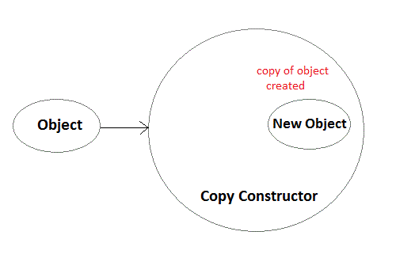
Syntax of Copy Constructor
Classname(const classname & objectname)
{
. . . .
}

Slide 97
#include<iostream>
using namespace std;
class Samplecopyconstructor
{
private:
int x, y; //data members
public:
Samplecopyconstructor(int x1, int y1)
{
x = x1;
y = y1;
}
/* Copy constructor */
Samplecopyconstructor (const Samplecopyconstructor &sam)
{
x = sam.x;
y = sam.y;
}
void display()
{
cout<<x<<" "<<y<<endl;
}
};
int main()
{
Samplecopyconstructor obj1(10, 15); // Normal constructor
Samplecopyconstructor obj2 = obj1; // Copy constructor
cout<<"Normal constructor : ";
obj1.display();
cout<<"Copy constructor : ";
obj2.display();
return 0;
}

Slide 98
Multilevel Inheritance
A class can also be derived from one class, which is already derived from another class.
In the following example, MyGrandChild is derived from class MyChild (which is derived from MyClass)
#include <iostream>
using namespace std;
class MyClass {
public:
void myFunction() {
cout << "Some content in parent class." ;
}
};
// Derived class (child)
class MyChild: public MyClass {
};
// Derived class (grandchild)
class MyGrandChild: public MyChild {
};
int main() {
MyGrandChild myObj;
myObj.myFunction();
return 0;
}

Slide 99
#include <iostream>
using namespace std;
class Animal {
public:
void eat() {
cout<<"Eating..."<<endl;
}
};
class Dog: public Animal
{
public:
void bark(){
cout<<"Barking..."<<endl;
}
};
class BabyDog: public Dog
{
public:
void weep() {
cout<<"Weeping...";
}
};
int main(void) {
BabyDog d1;
d1.eat();
d1.bark();
d1.weep();
return 0;
}

Slide 100
Multiple Inheritance
A class can also be derived from more than one base class, using a comma-separated list:
Syntax of the Derived class:
class D : visibility B-1, visibility B-2, ?
{
// Body of the class;
}

Slide 101
#include <iostream>
using namespace std;
// Base class
class MyClass {
public:
void myFunction() {
cout << "Some content in parent class.\n" ;
}
};
// Another base class
class MyOtherClass {
public:
void myOtherFunction() {
cout << "Some content in another class.\n" ;
}
};
// Derived class
class MyChildClass: public MyClass, public MyOtherClass {
};
int main() {
MyChildClass myObj;
myObj.myFunction();
myObj.myOtherFunction();
return 0;
}

Slide 102
Polymorphism in C++
The word polymorphism means having many forms. In simple words, we can define polymorphism as the ability of a message to be displayed in more than one form. Real life example of polymorphism, a person at the same time can have different characteristic. Like a man at the same time is a father, a husband, an employee. So the same person posses different behavior in different situations. This is called polymorphism
In C++ polymorphism is mainly divided into two types:
Compile time Polymorphism
Runtime Polymorphism

Slide 103
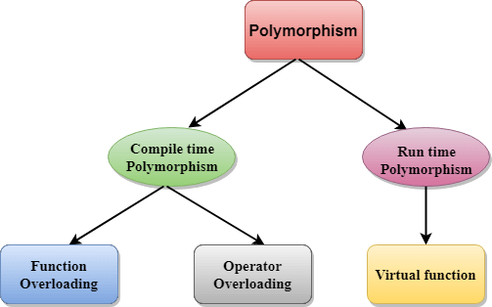
OR
Function overriding
Default constructor

Slide 104
Compile time polymorphism: This type of polymorphism is achieved by function overloading or operator overloading. Function Overloading: When there are multiple functions with same name but different parameters then these functions are said to be overloaded. Functions can be overloaded by change in number of arguments or/and change in type of arguments.

Slide 105
#include <iostream>
using namespace std;
class Niit
{
public:
// function with 1 int parameter
void func(int x)
{
cout << "value of x is " << x << endl;
}
// function with same name but 1 double parameter
void func(double x)
{
cout << "value of x is " << x << endl;
}
// function with same name and 2 int parameters
void func(int x, int y)
{
cout << "value of x and y is " << x << ", " << y << endl;
}
};
int main() {
Niit obj1;
// Which function is called will depend on the parameters passed
// The first 'func' is called
obj1.func(7);
// The second 'func' is called
obj1.func(9.132);
// The third 'func' is called
obj1.func(85,64);
return 0;
}

Slide 106
Runtime polymorphism: This type of polymorphism is achieved by Function Overriding.
Function overriding on the other hand occurs when a derived class has a definition for one of the member functions of the base class. That base function is said to be overridden.

Slide 107
Runtime Polymorphism can be achieved by data members in C++.
#include <iostream>
using namespace std;
class Animal { // base class declaration.
public:
string color = "Black";
};
class Dog: public Animal // inheriting Animal class.
{
public:
string color = "Grey";
};
int main(void) {
Animal d= Dog();
cout<<d.color;
}

Slide 108
C++ Runtime Polymorphism Example
Let's see a simple example of run time polymorphism in C++.
#include <iostream>
using namespace std;
class Animal {
public:
void eat(){
cout<<"Eating...";
}
};
class Dog: public Animal
{
public:
void eat()
{ cout<<"Eating bread...";
}
};
int main(void) {
Dog d = Dog();
d.eat();
return 0;
}

Slide 109
Virtual Function in C++
A virtual function a member function which is declared within a base class and is re-defined(Overriden) by a derived class.
Virtual Function is a function in base class, which is overrided in the derived class, and which tells the compiler to perform Late Binding on this function.
Virtual Keyword is used to make a member function of the base class Virtual
Virtual functions ensure that the correct function is called for an object, regardless of the type of reference used for function call.
They are mainly used to achieve Runtime polymorphism
Functions are declared with a virtual keyword in base class.
The resolving of function call is done at Run-time.

Slide 110
Rules for Virtual Functions
Virtual functions cannot be static and also cannot be a friend function of another class.
Virtual functions should be accessed using pointer or reference of base class type to achieve run time polymorphism.
The prototype of virtual functions should be same in base as well as derived class.
They are always defined in base class and overridden in derived class. It is not mandatory for derived class to override (or re-define the virtual function), in that case base class version of function is used.
A class may have virtual destructor but it cannot have a virtual constructor.

Slide 111
#include <iostream>
using namespace std;
class A
{
public:
virtual void display()
{
cout << "Base class is invoked"<<endl;
}
};
class B:public A
{
public:
void display()
{
cout << "Derived Class is invoked"<<endl;
}
};
int main()
{
A* a; //pointer of base class
B b; //object of derived class
a = &b;
a->display(); //Late Binding occurs
}

Slide 112
#include <iostream>
using namespace std;
class Base
{
public:
void show()
{
cout << "Base class";
}
};
class Derived:public Base
{
public:
void show()
{
cout << "Derived Class";
}
};
int main()
{
Base* b; //Base class pointer
Derived d; //Derived class object
b = &d;
b->show(); //Early Binding Ocuurs
}

Slide 113
#include <iostream>
using namespace std;
class Base
{
public:
virtual void show()
{
cout << "Base class\n";
}
};
class Derived:public Base
{
public:
void show()
{
cout << "Derived Class";
}
};
int main()
{
Base* b; //Base class pointer
Derived d; //Derived class object
b = &d;
b->show(); //Late Binding Ocuurs
}

Slide 114
Important Points to Remember
Only the Base class Method's declaration needs the Virtual Keyword, not the definition.
If a function is declared as virtual in the base class, it will be virtual in all its derived classes.

Slide 115
Compile time polymorphism | Run time polymorphism
The function to be invoked is known at the compile time. | The function to be invoked is known at the run time.
It is also known as overloading, early binding and static binding. | It is also known as overriding, Dynamic binding and late binding.
Overloading is a compile time polymorphism where more than one method is having the same name but with the different number of parameters or the type of the parameters. | Overriding is a run time polymorphism where more than one method is having the same name, number of parameters and the type of the parameters.
It is achieved by function overloading and operator overloading. | It is achieved by virtual functions and pointers.
It provides fast execution as it is known at the compile time. | It provides slow execution as it is known at the run time.
It is less flexible as mainly all the things execute at the compile time. | It is more flexible as all the things execute at the run time.

Slide 116
#include <iostream>
using namespace std;
class Cal {
public:
static int add(int a,int b){
return a + b;
}
static int add(int a, int b, int c)
{
return a + b + c;
}
};
int main() {
Cal C; // class object declaration.
cout<<C.add(10, 20)<<endl;
cout<<C.add(12, 20, 23);
return 0;
}

Slide 117
C++ Operators Overloading
Overloaded operators are functions with special names: the keyword "operator" followed by the symbol for the operator being defined. Like any other function, an overloaded operator has a return type and a parameter list.
Operator that cannot be overloaded are as follows:
Scope operator (::)
Sizeof
member selector(.)
member pointer selector(*)
ternary operator(?:)

Slide 118
Rules for Operator Overloading
Existing operators can only be overloaded, but the new operators cannot be overloaded.
The overloaded operator contains at least one operand of the user-defined data type.
We cannot use friend function to overload certain operators. However, the member function can be used to overload those operators.
When unary operators are overloaded through a member function take no explicit arguments, but, if they are overloaded by a friend function, takes one argument.
When binary operators are overloaded through a member function takes one explicit argument, and if they are overloaded through a friend function takes two explicit arguments.

Slide 119
#include <iostream>
using namespace std;
class Test
{
private:
int num;
public:
Test(){
num=8;
}
void operator ++() {
num = num+2;
}
void Print() {
cout<<"The Count is: "<<num; //10
}
};
int main()
{
Test tt;
++tt; // calling of a function "void operator ++()"
tt.Print();
return 0;
}

Slide 120
#include <iostream>
using namespace std;
class A
{
int x;
public:
A(){}
A(int i)
{
x=i;
}
void operator+(A);
void display();
};
void A :: operator+(A a)
{
int m = x+a.x;
cout<<"The result of the addition of two objects is : "<<m;
}
int main()
{
A a1(5);
A a2(4);
a1+a2;
return 0;
}

Slide 121
Abstraction
Data Abstraction is a process of providing only the essential details to the outside world and hiding the internal details, i.e., representing only the essential details in the program.
Data Abstraction is a programming technique that depends on the separation of the interface and implementation details of the program.

Slide 122
Data Abstraction can be achieved in two ways:
Abstraction using classes
Abstraction in header files.

Slide 123
Abstraction using classes: An abstraction can be achieved using classes. A class is used to group all the data members and member functions into a single unit by using the access specifies.
#include <iostream>
using namespace std;
class Sum
{
private: int x, y, z; // private variables
public:
void add()
{
cout<<"Enter two numbers: ";
cin>>x>>y;
z= x+y;
cout<<"Sum of two number is: "<<z<<endl;
}
};
int main()
{
Sum sm;
sm.add();
return 0;
}

Slide 124
Abstraction in header files: An another type of abstraction is header file. For example, pow() function available is used to calculate the power of a number without actually knowing which algorithm function uses to calculate the power.
#include <iostream>
#include<math.h>
using namespace std;
int main()
{
int power = 3;
int number = 4;
int result = pow(power,number); // pow(n,power) is the power function
std::cout << "power of n is : " <<result<< std::endl;
return 0;
}

Slide 125
Advantages Of Abstraction:
A programmer does not need to write the low level code.
Data Abstraction avoids the code duplication, i.e., programmer does not have to undergo the same tasks every time to perform the similar operation.
The main aim of the data abstraction is to reuse the code and the proper partitioning of the code across the classes.
Internal implementation can be changed without affecting the user level code

Slide 126
Encapsulation is defined as wrapping up of data and information under a single unit. In Object Oriented Programming, Encapsulation is defined as binding together the data and the functions that manipulates them
How Encapsulation is achieved in a class
To do this: 1) Make all the data members private.

Slide 127
#include <iostream>
using namespace std;
class implementAbstraction
{
private:
int a, b;
public:
// method to set values of
// private members
void set(int x, int y)
{
a = x;
b = y;
}
void display()
{
cout<<"a = " <<a << endl;
cout<<"b = " << b << endl;
}
};
int main()
{
implementAbstraction obj;
obj.set(10, 20);
obj.display();
return 0;
}

Slide 128
#include<iostream>
using namespace std;
class Encapsulation
{
private:
// data hidden from outside world
int x;
public:
void set(int a)
{
x =a;
}
int get()
{
return x;
}
};
int main()
{
Encapsulation obj;
obj.set(5);
cout<<obj.get();
return 0;
}

Slide 129
C++ Exception Handling
Exceptions provide a way to transfer control from one part of a program to another. C++ exception handling is built upon three keywords: try, catch,and throw.
throw − A program throws an exception when a problem shows up. This is done using a throw keyword.
catch − A program catches an exception with an exception handler at the place in a program where you want to handle the problem.
The catch keyword indicates the catching of an exception.
try − A try block identifies a block of code for which particular exceptions will be activated. It's followed by one or more catch blocks.

Slide 130
Throwing Exceptions
Exceptions can be thrown anywhere within a code block using throwstatement.
double division(int a, int b) {
if( b == 0 ) {
throw "Division by zero condition!";
}
return (a/b);
}

Slide 131
Catching Exceptions
The catch block following the try block catches any exception. You can specify what type of exception you want to catch and this is determined by the exception
try {
// protected code
} catch( ExceptionName e ) {
// code to handle ExceptionName exception
}

Slide 132
#include <iostream>
using namespace std;
int main()
{
int x = -1;
// Some code
cout << "Before try \n";
try {
cout << "Inside try \n";
if (x < 0)
{
throw x;
cout << "After throw (Never executed) \n";
}
}
catch (int x ) {
cout << "Exception Caught \n";
}
cout << "After catch (Will be executed) \n";
return 0;
}

Slide 133
#include <iostream>
using namespace std;
int main()
{
try {
throw 'a';
}
catch (int x) {
cout << "Caught " << x;
}
catch (...) {
cout << "Default Exception\n";
}
return 0;
}

Slide 134
C++ example without try/catch
#include <iostream>
using namespace std;
float division(int x, int y) {
return (x/y);
}
int main () {
int i = 50;
int j = 0;
float k = 0;
k = division(i, j);
cout << k << endl;
return 0;
}

Slide 135
C++ try/catch example
#include <iostream>
using namespace std;
float division(int x, int y) {
if( y == 0 ) {
throw "Attempted to divide by zero!";
}
return (x/y);
}
int main () {
int i = 25;
int j = 0;
float k = 0;
try {
k = division(i, j);
cout << k << endl;
}catch (const char* e) {
cerr << e << endl;
}
return 0;
}

Slide 136
#include <iostream>
#include <exception>
using namespace std;
class MyException : public exception{
public:
const char * what() const throw()
{
return "Attempted to divide by zero!\n";
}
};
int main()
{
try
{
int x, y;
cout << "Enter the two numbers : \n";
cin >> x >> y;
if (y == 0)
{
MyException z;
throw z;
}
else
{
cout << "x / y = " << x/y << endl;
}
}
catch(exception& e)
{
cout << e.what();
}
}
C++ user-defined exception example
Let's see the simple example of user-defined exception in which std::exception class is used to define the exception

Slide 137
C++ Strings
In C++, string is an object of std::string class that represents sequence of characters. We can perform many operations on strings such as concatenation, comparison, conversion
#include <iostream>
using namespace std;
int main( ) {
string s1 = "Hello";
char ch[] = { 'C', '+', '+'};
string s2 = string(ch);
cout<<s1<<endl;
cout<<s2<<endl;
}

Slide 138
#include <iostream>
#include <cstring>
using namespace std;
int main ()
{
char key[] = "mango";
char buffer[50];
do {
cout<<"What is my favourite fruit? ";
cin>>buffer;
} while (strcmp (key,buffer) != 0);
cout<<"Answer is correct!!"<<endl;
return 0;
}

Slide 139
#include <iostream>
#include <cstring>
using namespace std;
int main()
{
char key[25], buffer[25];
cout << "Enter the key string: ";
cin.getline(key, 25);
cout << "Enter the buffer string: ";
cin.getline(buffer, 25);
strcat(key, buffer);
cout << "Key = " << key << endl;
cout << "Buffer = " << buffer<<endl;
return 0;
}

Slide 140
#include <iostream>
#include <cstring>
using namespace std;
int main()
{
char key[25], buffer[25];
cout << "Enter the key string: ";
cin.getline(key, 25);
strcpy(buffer, key);
cout << "Key = "<< key << endl;
cout << "Buffer = "<< buffer<<endl;
return 0;
}

Slide 141
C++ Strings
In C++, string is an object of std::string class that represents sequence of characters. We can perform many operations on strings such as concatenation, comparison, conversion etc
#include <iostream>
using namespace std;
int main( ) {
string s1 = "Hello";
char ch[] = { 'C', '+', '+'};
string s2 = string(ch);
cout<<s1<<endl;
cout<<s2<<endl;
}

Slide 142
C++ String Compare Example
#include <iostream>
#include <cstring>
using namespace std;
int main ()
{
char key[] = "mango";
char buffer[50];
do {
cout<<"What is my favourite fruit? ";
cin>>buffer;
} while (strcmp (key,buffer) != 0);
cout<<"Answer is correct!!"<<endl;
return 0;
}

Slide 143
C++ String Concat Example
#include <iostream>
#include <cstring>
using namespace std;
int main()
{
char key[25], buffer[25];
cout << "Enter the key string: ";
cin.getline(key, 25);
cout << "Enter the buffer string: ";
cin.getline(buffer, 25);
strcat(key, buffer);
cout << "Key = " << key << endl;
cout << "Buffer = " << buffer<<endl;
return 0;
}

Slide 144
C++ String Copy Example
Let's see the simple example of copy the string using strcpy() function.
#include <iostream>
#include <cstring>
using namespace std;
int main()
{
char key[25], buffer[25];
cout << "Enter the key string: ";
cin.getline(key, 25);
strcpy(buffer, key);
cout << "Key = "<< key << endl;
cout << "Buffer = "<< buffer<<endl;
return 0;
}

Slide 145
C++ String Length Example
Let's see the simple example of finding the string length using strlen() function.
#include <iostream>
#include <cstring>
using namespace std;
int main()
{
char ary[] = "Welcome to C++ Programming";
cout << "Length of String = " << strlen(ary)<<endl;
return 0;
}

Slide 146
#include <iostream>
#include <cstring>
using namespace std;
int main () {
char str1[10] = “NIIT";
char str2[10] = “NOIDA";
char str3[10];
int len ;
// copy str1 into str3
strcpy( str3, str1);
cout << "strcpy( str3, str1) : " << str3 << endl;
// concatenates str1 and str2
strcat( str1, str2);
cout << "strcat( str1, str2): " << str1 << endl;
// total lenghth of str1 after concatenation
len = strlen(str1);
cout << "strlen(str1) : " << len << endl;
return 0;
}

Slide 147
#include <iostream>
#include <string>
using namespace std;
int main () {
string str1 = “NIIT";
string str2 = “NOIDA";
string str3;
int len ;
// copy str1 into str3
str3 = str1;
cout << "str3 : " << str3 << endl;
// concatenates str1 and str2
str3 = str1 + str2;
cout << "str1 + str2 : " << str3 << endl;
// total length of str3 after concatenation
len = str3.size();
cout << "str3.size() : " << len << endl;
return 0;
}

Slide 149
Templates are features of C++ which allows you to write generic programs. In simple terms, you can create a single function or a class to work with different data types using templates.
Templates are often used in larger codebase for the purpose of code reusability and flexibility of the programs.
The concept of templates can be used in two different ways:
Function Templates
Class Templates

Slide 150
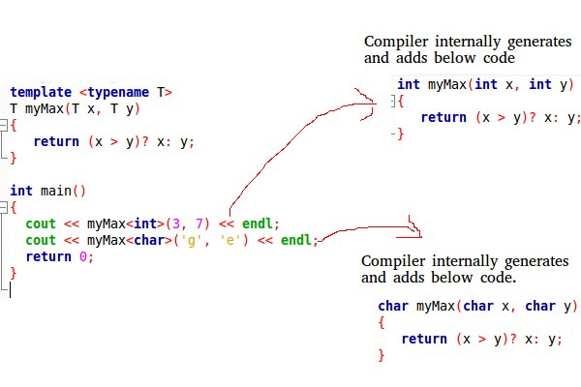

Slide 151
Function Templates
A function template works in a similar to a normal function, with one key difference.
A single function template can work with different data types at once but, a single normal function can only work with one set of data types.

Slide 152
A function template starts with the keyword template followed by template parameter/s inside < > which is followed by function declaration.
template <class T> T someFunction(T arg) { ... .. ... }

Slide 153
#include <iostream>
using namespace std;
// One function works for all data types. This would work
// even for user defined types if operator '>' is overloaded
template <typename T>
T myMax(T x, T y)
{
return (x > y)? x: y;
}
int main()
{
cout << myMax<int>(3, 7) << endl; // Call myMax for int
cout << myMax<double>(3.0, 7.0) << endl; // call myMax for double
cout << myMax<char>('g', 'e') << endl; // call myMax for char
return 0;
}

Slide 154
#include <iostream>
using namespace std;
// template function
template <class T>
T Large(T n1, T n2)
{
return (n1 > n2) ? n1 : n2;
}
int main()
{
int i1, i2;
float f1, f2;
char c1, c2;
cout << "Enter two integers:\n";
cin >> i1 >> i2;
cout << Large(i1, i2) <<" is larger." << endl;
cout << "\nEnter two floating-point numbers:\n";
cin >> f1 >> f2;
cout << Large(f1, f2) <<" is larger." << endl;
cout << "\nEnter two characters:\n";
cin >> c1 >> c2;
cout << Large(c1, c2) << " has larger ASCII value.";
return 0;
}

Slide 155
Class Templates
Like function templates, you can also create class templates for generic class operations.
Sometimes, you need a class implementation that is same for all classes, only the data types used are different.

Slide 156
How to declare a class template?
template <class T>
class className
{
... .. ...
public:
T var;
T someOperation(T arg);
... .. ...
};

Slide 157
#include <iostream>
using namespace std;
template <typename T>
class Array {
private:
T *ptr;
int size;
public:
Array(T arr[], int s);
void print();
};
template <typename T>
Array<T>::Array(T arr[], int s) {
ptr = new T[s];
size = s;
for(int i = 0; i < size; i++)
ptr[i] = arr[i];
}
template <typename T>
void Array<T>::print() {
for (int i = 0; i < size; i++)
cout<<" "<<*(ptr + i);
cout<<endl;
}
int main() {
int arr[5] = {1, 2, 3, 4, 5};
Array<int> a(arr, 5);
a.print();
return 0;
}

Slide 158
#include<iostream>
using namespace std;
template<class T, class U>
class A {
T x;
U y;
public:
A() { cout<<"Constructor Called"<<endl; }
};
int main() {
A<char, char> a;
A<int, double> b;
return 0;
}

